Slide 1
Campus Forum
Spring 2018

Slide 2
Thank you!
100 Days of Different
Strategic plan
Student survey (Spring 2018)
Orange pulse survey
Budget

Slide 3
100 Days of Different
A&M Regents approved OSU-OKC’s revised mission statement that emphasizes:
Industry-relevance
Student diversity
Innovative technology
Experienced faculty and staff
Emphasizes outcomes:
Personal growth
Graduation
Employment supporting the needs of a multi-cultural region

Slide 4
100 Days of Different
Who are we?
Strategic plan update (Tracy, Lisa, Patti work reviewed for alignment against HLC criteria)
Spring student survey
Orange Pulse survey
What is happening?
Communication channels
Higher Good, non-agenda lunches, reinforce the system’s chain of command
Meetings with advisory boards, business and industry, area high schools, non-profit leaders
Identify regional needs and our role
Understanding the budget and impacts of state allocations
What can we accomplish, together

Slide 5
Prior Mission & Strategic Plan Goals
Who are we?
Oklahoma State University – Oklahoma City develops and delivers collegiate level career transfer educational programs, professional development and support services which prepare individuals to live and work in an increasingly technological global community.
Goal 1: Improve student success, retention and subsequent graduation rates of all students attending Oklahoma State University – Oklahoma City.
Goal 2: Ensure the highest standards of excellence in teaching and learning both inside and outside the traditional instructional environment.
Goal 3: Secure resources needed to fulfill the OSU-OKC mission and maximize the effective and efficient use of those resources.
Goal 4: Increase the institution’s engagement & marketing in the community and regional through programs and activities.
Goal 5: Enhance the relationship between OSU-OKC and the Stillwater campus and other partners, as appropriate.
Goal 6: Maintain progressive infrastructure plans that evolve with the campus mission to support the university community.
Goal 7: Support a culture that values a diverse and inclusive learning and working environment.

Slide 6
Revised Mission
Who are we?
OSU-OKC provides industry-relevant higher education for a diverse student population through innovative technology and experienced faculty and staff; leading to personal growth, graduation, and employment that supports the needs of a multi-cultural region.
Simplify the goal structure
Goal 1: Improve student success, persistence, retention and completion rates, and students’ transition to work or further education.
Goal 2: Recruit, develop, and retain quality faculty and staff.
Goal 3: Engage OSU-OKC’s internal and external stakeholders in activities that support the campus’ delivery of industry-relevant education.
Student success. Employee Excellence. Industry relevant.

Slide 7
Who are we?
Student success. Employee Excellence. Industry relevant.
We are what we value…
We take ownership of our daily actions that support these themes
We respect our colleagues’ role and contribution to the mission and plan
We trust and respect others because we, ourselves, want to be trusted and respected
We assess our individual and collective efforts, and adjust accordingly
We embrace continuous improvement and document the journey
Draft plan disseminated to campus for review and comment (mid-April)

Slide 8
Where are we?
What’s the pulse?
Survey launch January 30
Questions 26
Respondents 178 employees (129 Staff, 49 Faculty)
Training and development
Personal fulfillment
Compensation and recognition
Workload and work/life balance
Workplace environment
Open-ended questions

Slide 9
Where are we?
Survey launch January 30
Questions 26
Respondents 178 employees
129 Staff
49 Faculty
Open-ended questions
Opportunity to express pain and disappointment
Opportunity to better understand as a path to healing
Presentation of responses to open-ended question
We’re not going to destroy people
We will center on the process and not the person

Slide 10
Where are we?
Survey launch January 30
Questions 26
Respondents 178 employees
129 Staff
49 Faculty
What motivates you to do your best work?
What would make you want to leave OSU-OKC?
What drives you crazy here?
Three words to describe the culture.

Slide 11
What motivates you to do your best work?

Slide 12
What would make you want to leave OSU-OKC?

Slide 13
What drives you crazy here?

Slide 14
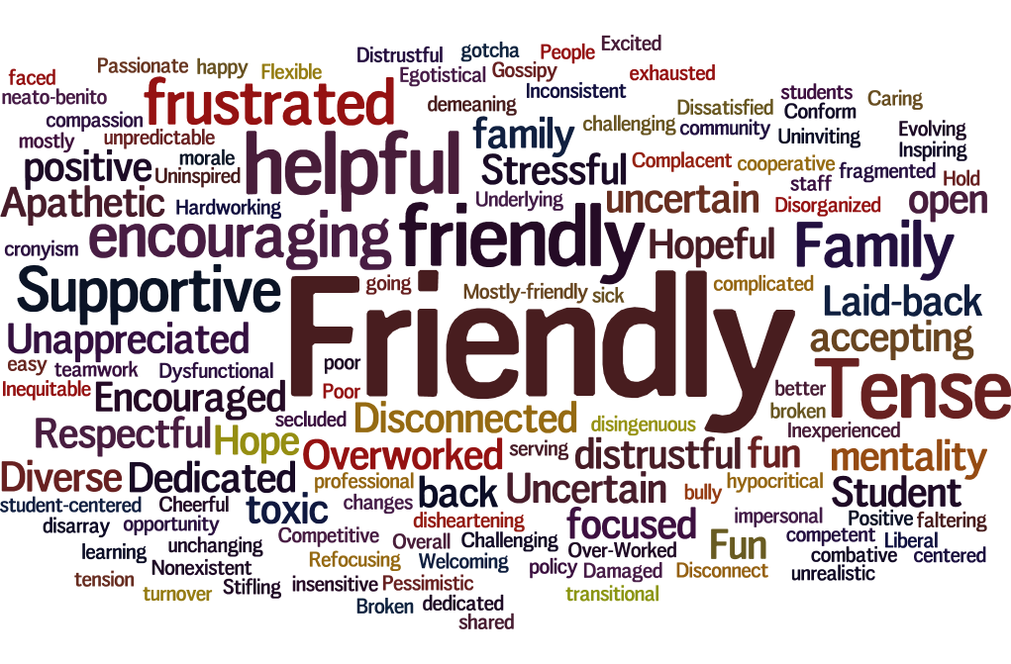
Three words to describe the culture.

Slide 15
Where are we?
We are what we value…
Do we take ownership of our daily actions?
Do we respect our colleagues’ role and contribution to the mission and plan?
Do we trust and respect others because we, ourselves, want to be trusted and respected?
Do we assess our individual and collective efforts, and adjust accordingly?
Do we embrace continuous improvement and document the journey?

Slide 16
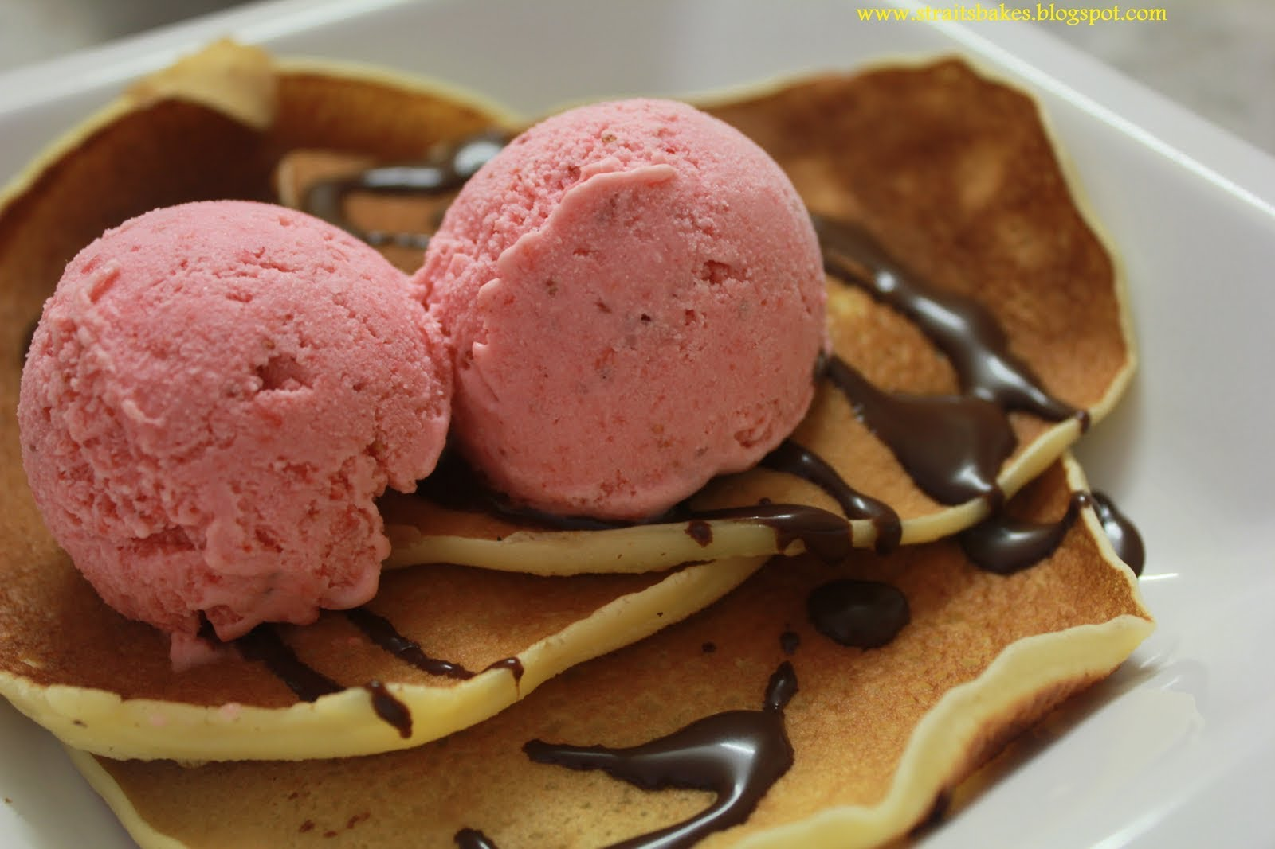
Path to a new us.
It is going to take more than pancakes and ice cream to heal the campus, but these things bring us together and remind us we’re a member of a community.
Each one of us shapes the culture. Is my contribution positive or negative?
We all have a role in building culture and, then, believing in it to sustain it.
Acknowledge processes that generate widespread pain for us, or others, and collaborate to resolve.
Establish a training and development program that pushes us forward.

Slide 17
WOW! WEEK April 9 – 13
Path to a new us.
Random acts of appreciation for co-workers
The Daily Dozen – Daily delivery of a dozen donuts
Nominate someone online to receive a “Shout Out!”
Send a “You Make a Difference” notecard
Popcorn Day and Ice Cream Day
Photos of Service Award winners on display in the Hub

Slide 18
Campus will close to emphasize the event’s importance.
Unique awards that celebration OSU-OKC’s identity.
Celebration of employment milestones and staff and faculty excellence awards.

Slide 20
SP/BD
Budget
OSU-OKC provides industry-relevant higher education for a diverse student population through innovative technology and experienced faculty and staff; leading to personal growth, graduation, and employment that supports the needs of a multi-cultural region.
Student success. Employee Excellence. Industry relevant.
We are what we value…
We take ownership of our daily actions that support these themes
We respect our colleagues’ role and contribution to the mission and plan
We trust and respect others because we, ourselves, want to be trusted and respected
We assess our individual and collective efforts, and adjust accordingly
We embrace continuous improvement and document the journey

Slide 21
SP/BD
Budget
Entry open through close of business March 30
Requests/Modifications for personnel, M&O dollars and equipment will need to reference existing strategic plan
All requests/modifications are posted to SP/BD site once compiled
Final word on budget will be end of May/1st of June

Slide 22
Some History
Budget
Budget cut in FY16: -3.5% / -$408,216
Tuition: increased 3.5%
Enrollment: Fall -12.6%, Spring -6.9%
Budget cut in FY17: -15.95% / -$1,007,872
Tuition: increased 4%
Enrollment: Fall +1.1%, Spring -1.1%
Budget cut in FY18: -6.08% / -$575,298
Tuition: increased 3%
Enrollment: Fall -3.3%, Spring -3.3%
Estimate for FY19: -5 to -7% / -$444,204 to -$621,885
Tuition: still to be determined
Enrollment: Up!

Slide 23
What you said…
I’m inspired to go to work.
I’m excited to go to work.
I have a sense of personal accomplishment.
I am empowered to make decisions and find new and better ways.
I have positive working relationships.
My co-workers treat me with respect.
90% What I do makes a difference!

Slide 24
Students notice (Spring 2018 Survey)
Student Survey
Survey launch March 7, 2018
Questions 30
Responses 1,198
Agree/Strongly Agree
Friendly and helpful staff 90%
Quality instructors 85%
Education is worth the investment 91%
I am proud to attend 90%
I am being prepared for a career 85%
I would recommend OSU-OKC 93%

Slide 25
The following slides were not part of the original presentation, but convey employee responses to the multiple choice questions in the OrangePulse survey.

Slide 26
Training and Development
Agree Neutral Disagree

Slide 27
Fulfillment
Agree Neutral Disagree

Slide 28
Fulfillment
Agree Neutral Disagree

Slide 29
Fulfillment
Agree Neutral Disagree

Slide 30
Fulfillment
Agree Neutral Disagree

Slide 31
Compensation and Recognition
Agree Neutral Disagree

Slide 32
Workload
Agree Neutral Disagree

Slide 33
Workplace Environment
Agree Neutral Disagree

Slide 34
Workplace Environment
Agree Neutral Disagree

Slide 35
Workplace Environment
Agree Neutral Disagree

Slide 36
Discussion

